Slide 1
Wales culture
(культура Уэильса)

Slide 2
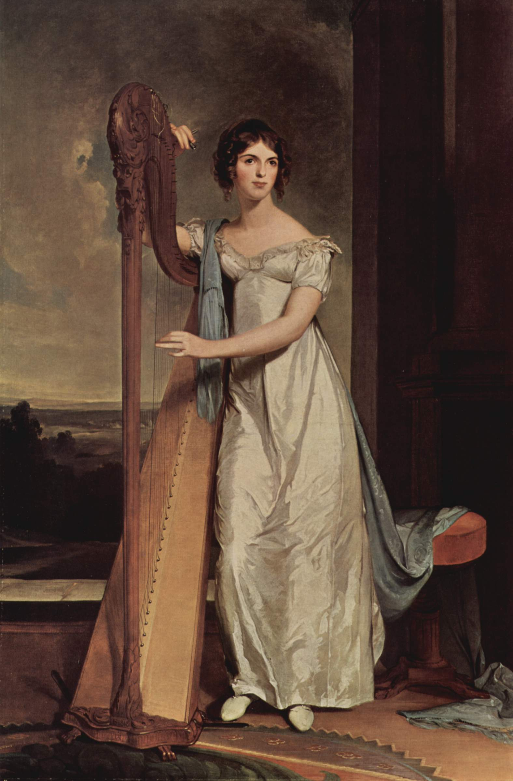
Music
Music
Main article: Music of Wales
Wales is often referred to as "the land of song",^{[1]} and is notable for its harpists, male choirs, and solo artists. The principal Welsh festival of music and poetry is the annual National Eisteddfod. The Llangollen International Eisteddfod echoes the National Eisteddfod but provides an opportunity for the singers and musicians of the world to perform. Traditional music and dance in Wales is supported by a myriad of societies. The Welsh Folk Song Society has published a number of collections of songs and tunes.
Traditional instruments of Wales include telyn deires (triple harp), fiddle, crwth, pibgorn (hornpipe) and other instruments.^{[2][3][4][5]} The Cerdd DantSociety promotes its specific singing art primarily through an annual one-day festival.
The BBC National Orchestra of Wales performs in Wales and internationally. The Welsh National Opera is based at the Wales Millennium Centre inCardiff Bay, while the National Youth Orchestra of Wales was the first of its type in the world.^{[6]}
Wales has a tradition for producing notable singing artists including Sir Geraint Evans, Dame Gwyneth Jones, Dame Anne Evans, Dame Margaret Price, Sir Tom Jones, Bonnie Tyler, Bryn Terfel, Mary Hopkin, Charlotte Church, Katherine Jenkins, Meic Stevens, Dame Shirley Bassey and Duffy.
Popular bands to have emerged from Wales have included the Beatles-nurtured power pop group Badfinger in the 1960s, Man and Budgie in the 1970s and The Alarm in the 1980s. Wales experienced a strong emergence of groups during the 1990s led by Manic Street Preachers, followed by the likes of the Stereophonics and Feeder; notable during this period were Catatonia, Super Furry Animals, and Gorky's Zygotic Mynci who gained popular success as dual-language artists. Recently successful Welsh bands include Lostprophets, Bullet for My Valentine, Funeral for a Friend andKids in Glass Houses. The Welsh traditional and folk music scene is in resurgence with performers and bands such as Crasdant, Carreg Lafar,Fernhill, Siân James and The Hennessys.
The emergence of male voice choirs in the 19th century, has remained a lasting tradition in Wales. Originally these choirs where formed as the tenor and bass sections of chapel choirs, and embraced the popular secular hymns of the day.^{[7]} Many of the historic choirs continue to survive in modern Wales singing a mixture of traditional and popular songs.

Slide 3
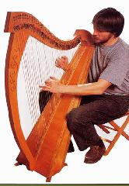
Музыка
Уэльс часто характеризуют фразой «Земля Песни», это говорит о близости народа к пению, поэзии и музыке. Наиболее известным видом музыкального творчества валлийцев является хор, особенно мужской. Хотя хоровое пение, безусловно, важная часть текущей музыкальной жизни Уэльса, это отнюдь не единственная и не самая древняя её часть, хоровые традиции на самом деле не уходят значительно дальше своего расцвета в XIX веке.
Самой древней музыкальной традицией Уэльса является инструментальная народная музыка. Традиционным для валлийской народной музыки музыкальным инструментом является арфа, а именно Уэльская тройная арфа. Также традиционными для Уэльса являются смычковая ротта и рожок pibgorn, которые, хотя и были вытеснены другими инструментами в XVIII веке, вновь получают некоторое распространение и в настоящее время.
В 1990-х валлийская музыка получает новое звучание, появляются новые музыкальные группы, такие как Super Furry Animals,Manic Street Preachers, Catatonia, Stereophonics и многие другие. В последние годы всё большее распространение получаютальтернативный рок и панк-рок, такие группы как Lostprophets, The Automatic и Funeral for a Friend добились международного признания.

Slide 4
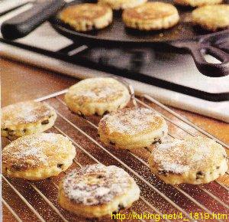
Cuisine
Wales is traditionally seen as an agrarian country and the traditional cuisines of Wales represent this heritage. Indeed, traditional foods tend to be simple, utilising readily-available ingredients and those cuts of meat that were not readily saleable. Baking is also a large part of the country's culinary culture and these dishes (such as Bara Brith [speckled bread]) tend to be fruitcakes that will keep for many days and were often served as a workman's tea. Traditional recipes such as lob scows (a lamb-based stew), Welsh rarebit, laver bread, brithyll abermeurig (Abermeurig trout) and Penclawdd cockles tend to be regional, reflecting the foods available in that region.
Of late, however, there has been a growing trend for many chefs to re-interpret these dishes in a more modern, fusion context.^{[11]} Though leeks and onions are commonly used during the year they tend to feature even more prominently in the recipes for St David's day and that other staple of the Welsh diet, locally produced lamb is also used. These days, however, more trout (especially sea trout, sewin) is also used. Traditionally on St David's day, many Welsh families enjoy cawl, a Welsh stew, containing meat (normally lamb or beef), potatoes, swede, leeks and a vaiety of other root vegetables.^{[citation needed]}

Slide 5
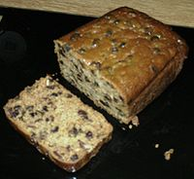
Кухня
Уэльс традиционно рассматривается как аграрный регион и его традиционная кухня этому соответствует. При приготовлении пищи используются традиционные продукты питания. Выпечка представляет самую богатую часть кулинарной культуры Уэльса, известны различные кексы, «пятнистый хлеб» (бара брит), который можно хранить в течение длительного времени.
В последнее время многие повара готовят традиционные валлийские блюда в новом виде. Широко используется лук-порей, особенно в блюдах, приготовленных ко Дню Святого Давида. Также всё более традиционными для валлийской кухни становятся блюда из баранины и рыбы.

Slide 6
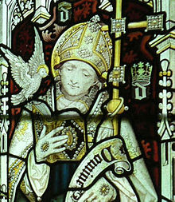
Saint David
Saint David (c. 500–589) (Welsh: Dewi Sant) was a Welsh Bishop during the 6th century; he was later regarded as a saint and as thepatron saint of Wales. David was a native of Wales, and a relatively large amount of information is known about his life. However, his birth date is still uncertain, as suggestions range from 462 to 512. The Annales Cambriae has his death at 601, which would move his birth date forward.^{[1]}

Slide 7
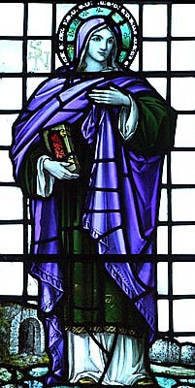
Давид Валлийский
Святой Давид Валлийский (около 500 — по одним данным 587, по другим около 601) — (лат. David, валл. Dewi), Давид Меневийский — епископ, просветитель и святой покровитель Уэльса. Почитается как святой в католической^{[1]}, англиканской^{[2]} иправославной^{[3]} церквах.

Slide 8
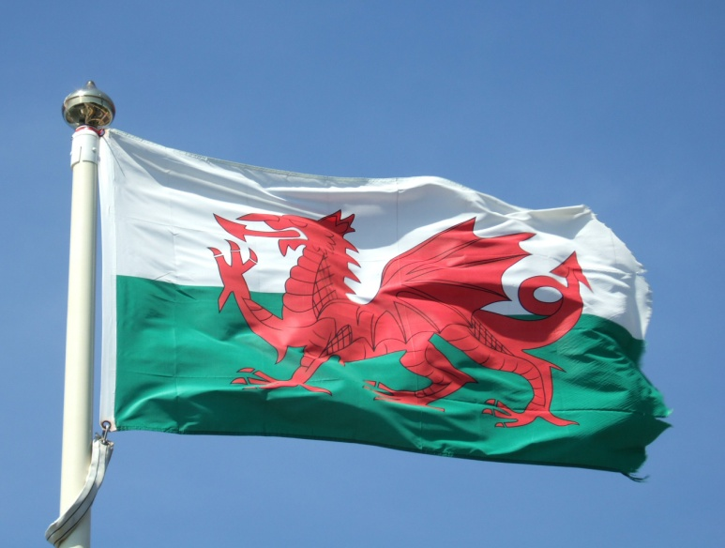
Flag of Wales
The Flag of Wales (Welsh: Baner Cymru or Y Ddraig Goch, meaning "The Red Dragon") consists of a red dragon passant on a green andwhite field. As with many heraldic charges, the exact representation of the dragon is not standardised and many renderings exist.
The flag incorporates the Red Dragon of Cadwaladr, King of Gwynedd, along with the Tudor colours of green and white. It was used byHenry VII at the Battle of Bosworth Field in 1485 after which it was carried in state to St Paul's Cathedral. The red dragon was then included in the Tudor royal arms to signify their Welsh descent. It was officially recognised as the Welsh national flag in 1959.
Wales and Bhutan are the only countries to have a dragon as a major design element on their flag, though the Chinese flag also featured a dragon during the Qing Dynasty, and a dragon appears on the badge of the George Cross on the flag of Malta.

Slide 9
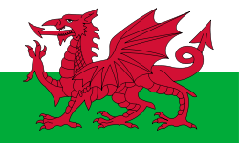
Флаг Уэльса
Флаг Уэльса представляет собой изображение красного дракона (валл. Y Ddraig Goch) на белом и зелёном фоне. Законодательно принят в 1959 г., хотя красный дракон являлся символом Уэльса с незапамятных (по распространённому представлению, римских) времён. В Средние века (при династии Тюдоров) белый и зелёный цвета также ассоциируются с Уэльсом. Это единственный из флагов частей Соединённого Королевства, не включённый в его флаг, что вызывает определённую критику.^{[1]}

